Slide 1
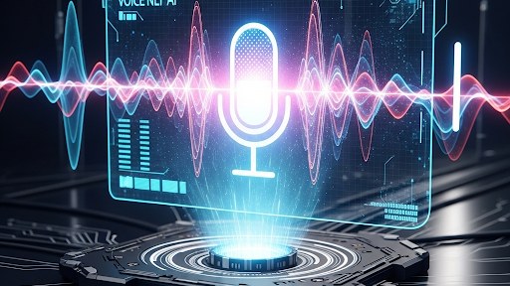
Voice Agent
Voice Flow : Intelligent Voice-Controlled Automation Revolutionizing Human-Computer Interaction
S. Chanakya

Slide 2
Introduction - The Vision Behind VoiceFlow
Key Points
1. Addressing a Core Challenge: Bridging the gap between human intent and computer execution.
2. Natural Interaction: Moving beyond mouse and keyboard.
3. Efficiency Gains: Streamlining repetitive tasks.
4. Accessibility: Empowering users with different needs.
5. Innovation: A leap forward in human-computer interaction.
6. Core Promise: Execute complex tasks with simple voice commands.
Notes:
We live in an increasingly digital world, but our interactions with computers often remain rooted in traditional methods: typing and clicking. Today, we're here to introduce VoiceFlow, a groundbreaking solution designed to fundamentally transform how we interact with technology, making it more intuitive, efficient, and accessible than ever before.

Slide 3
2: The Problem We Solve - The Status Quo
Key Points:
7. Inefficiency of Manual Tasks: Repetitive clicks and typing.
. Cognitive Load: Shifting focus from content to navigation.
9. Limited Current Voice Tech: Basic commands, not intelligent UI interaction.
10. The Gap: Need for a voice solution that sees and interacts with the screen.
Notes:
Think about your daily workflow. How many times do you navigate through menus, click on specific buttons, or type in URLs? This repetitive interaction, while familiar, can be time-consuming, prone to errors, and often takes our focus away from the core task at hand. Current voice solutions primarily offer basic commands or dictate text, but they lack the intelligence to truly understand and interact with complex graphical user interfaces. We recognized this limitation and built VoiceFlow to overcome it.

Slide 4
3: Introducing VoiceFlow - How it Works (Conceptual Diagram)
Key Points:
11. Modular Architecture: Three distinct, yet integrated, agents.
12. Voice-First Input: Natural language processing.
13. Intelligent Routing: Commands sent to the correct component.
14. Seamless Workflow: Agents collaborate for task completion.
Notes:
At its core, VoiceFlow is an intelligent three-component system working in perfect harmony. When you speak a command, our Voice Agent captures it. This command is then intelligently routed to either our Scan Agent for on-screen analysis or our Executor Agent for direct action. This modular design allows for incredible flexibility and power.

Slide 5
4: Deep Dive: The Voice Agent - Your Digital Listener
Speech-to-Text (STT): Core voice recognition.
Natural Language Understanding (NLU): Interpreting user intent.
Intent Recognition: Differentiating 'open' from 'scan'.
Robust ASR (Automatic Speech Recognition): High accuracy in various environments.
Notes:
The Voice Agent is the ear of our system. It's built on robust speech-to-text (STT) technology, converting your spoken words into actionable text. But it's more than just transcription; it leverages advanced Natural Language Understanding (NLU) to interpret your intent. For example, if you say 'Open GitHub,' it understands you mean to launch the GitHub website. This agent is the crucial first step in translating human language into machine commands.

Slide 6

5: Deep Dive: The Scan Agent - The Eyes of the System
UI Introspection: Programmatic understanding of screen elements.
Element Identification: Recognizing buttons, links, text boxes, etc.
Dynamic Interaction: Adapting to various web pages and applications.
Contextual Awareness: Understanding the active window/application.
Accessibility Principles: Adapting methodologies for interaction.
Notes:
The Scan Agent is where VoiceFlow truly shines. Unlike basic voice assistants, our Scan Agent acts as the 'eyes' of the system. When you say, 'Scan this page,' it programmatically reads and understands the elements on your screen. Using sophisticated UI introspection techniques, similar to how accessibility tools work, it identifies buttons, links, text fields, and other interactive elements. It then presents these controls in an audible format, allowing you to verbally select and interact with them – for instance, 'Click on 'Sign In',' or 'Type 'My Username' into the username field'.

Slide 7
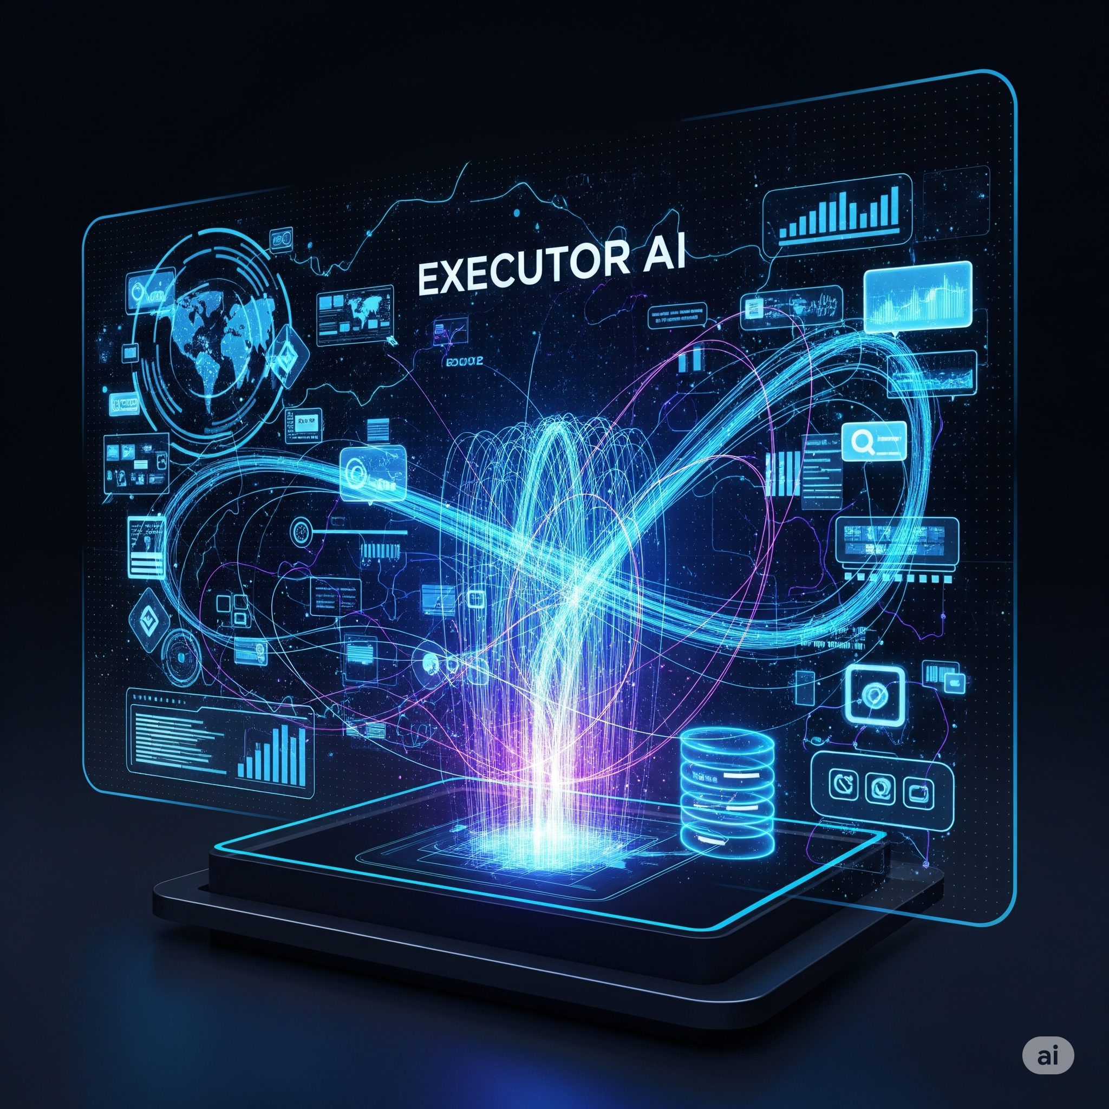
6: Deep Dive: The Executor Agent - The Action Taker
Programmatic UI Interaction: Simulating mouse clicks and keyboard inputs.
Cross-Platform Potential: Python and .NET for broad compatibility.
RPA Integration Potential: Foundation for advanced automation.
Direct System Control: Operating at the OS and application level.
Notes:
Finally, the Executor Agent is the hand that performs the action. Once the Voice Agent understands your command and the Scan Agent identifies the target UI element, the Executor Agent steps in. Leveraging powerful automation libraries in Python and .NET, it programmatically interacts with the user interface. This could be opening a URL, clicking a button, entering text, or even navigating through complex workflows. It’s analogous to a highly intelligent, voice-controlled robotic process automation (RPA) bot that responds instantly to your spoken word.

Slide 8

7: The Underlying Technology Stack - The Power Behind VoiceFlow
Speech-to-Text (STT) Engines: Core voice transcription.
Natural Language Processing (NLP): For intent and entity recognition.
UI Automation Frameworks (e.g., PyAutoGUI, UIPath, Selenium for web) For screen interaction.
Python:Versatility, scripting, rapid development.
NETEnterprise-grade, Windows integration, performance.
API Integration: For specific application control.
Computer Vision (Optional/Advanced):For complex UI analysis.
Machine Learning Models: For NLU and potentially adaptive UI understanding.
Notes:
The robustness of VoiceFlow comes from a carefully selected and integrated technology stack.
For our Voice Agent, we harness advanced Speech-to-Text (STT) engines and custom-trained Natural Language Processing (NLP) models to accurately interpret spoken commands and user intent. This includes libraries for intent classification and entity recognition.
The Scan Agent leverages powerful UI Automation frameworks available in both Python and .NET. These frameworks allow us to inspect, identify, and map elements within various applications, whether they are web-based, desktop applications, or even legacy systems.
For the Executor Agent, we utilize Python's robust scripting capabilities for cross-platform automation and .NET for deep integration with Windows-specific applications and enterprise systems. This dual-language approach ensures maximum compatibility and performance.
We can integrate with various API's for specific application control where direct UI interaction isn't feasible, and even employ Computer Vision (CV) for more complex or unconventional UI layouts where traditional UI inspection falls short.

Slide 9

: Use Cases - Where VoiceFlow Shines
The applications for VoiceFlow are vast and transformative:
Enhanced Productivity: Imagine a developer saying 'Open project X in Visual Studio,' or 'Run tests,' without touching their keyboard.
Contact Centers: Agents can navigate complex CRM systems with voice, focusing on the customer rather than struggling with interfaces.
Accessibility: Providing unparalleled access for individuals with motor impairments, enabling full computer control through voice.
Data Entry & Management: Quickly inputting data into forms or spreadsheets by simply speaking.
Industrial Automation & Control: Operating machinery or monitoring systems hands-free in specialized environments.
Healthcare: Clinicians navigating patient records or initiating procedures with voice commands, maintaining sterile conditions.
Gaming & Simulation: A more immersive and intuitive control experience.
VoiceFlow isn't just a convenience; it's a powerful tool for empowerment and efficiency across diverse industries.

Slide 10

9: What Makes VoiceFlow Unique? - Our Competitive Edge
While basic voice assistants exist, VoiceFlow stands apart due to several critical differentiators:
Deep UI Interaction: Unlike dictation tools or simple command interpreters, VoiceFlow can 'see' and intelligently interact with any graphical user interface, not just pre-programmed commands.
Adaptive Learning (Potential): Our architecture allows for future integration of machine learning to adapt to user habits and custom application layouts.
Hybrid Technology Stack: The strategic blend of Python and .NET provides both flexibility for rapid development and the power for deep system integration.
Modular & Scalable: Our three-agent architecture is inherently scalable, allowing us to add new capabilities and integrate with more systems seamlessly.
Focus on Actionable Automation: We don't just understand voice; we empower it to control and automate complex digital processes.
Robust Error Handling (Future enhancement): Designed to provide intelligent feedback and recovery mechanisms.
We're moving beyond mere voice recognition to true voice-enabled automation.

Slide 11
10: Conclusion - The Future is Voice-Controlled
In conclusion, VoiceFlow represents the next evolution in human-computer interaction. We are not just building a product; we are pioneering a new paradigm where your voice becomes the ultimate interface for all digital tasks. VoiceFlow will empower your teams, enhance productivity, and open up new avenues for accessibility and efficiency.
We invite you to experience the future of interaction. Thank you.
Call to Action (Optional, for you to consider):
We'd be happy to provide a live demonstration.
Let's discuss how VoiceFlow can transform your specific operations.

Slide 12
Thankyou
Voice controlled system

